Slide 1
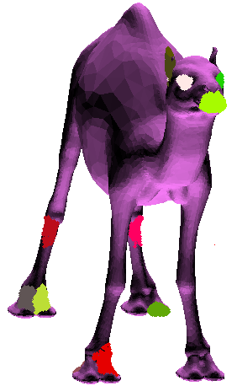
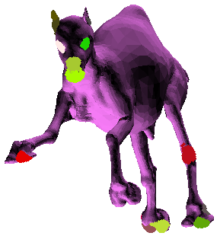
Using Local Moment Invariants for Partial 3D Shape Matching and Retrieval
Ammar Hattab
2013
Digital Geometry Course
Prof. Gabriel Tabuin

Slide 2
Project Goal
Moment Invariants are normally used as Global shape descriptors.
The goal of this project is to use them as a Local shape descriptor.
And to build a 3D shape retrieval and matching system based on moment invariants.

Slide 3
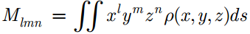
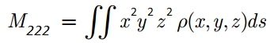
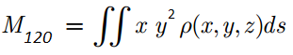
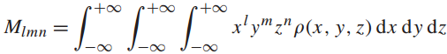
Moment
In mathematics, a moment is a quantitative measure of the shape of a set of points (its related to mean, variance, skewness…etc)
3D Surface Moment of order (l + m + n):
Examples:
In 3D, Moments could be defined on surface or on volume:
3D Volume Moment:

Slide 4
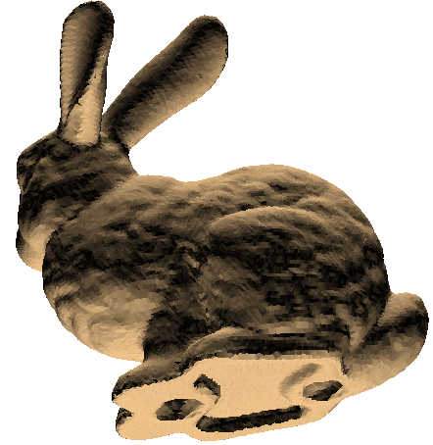
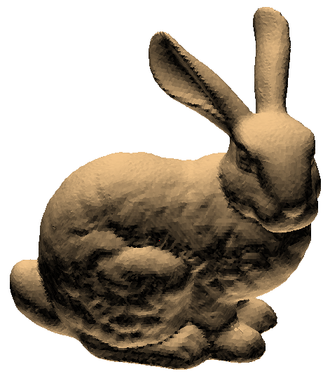
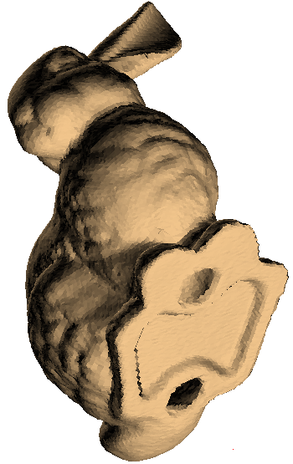
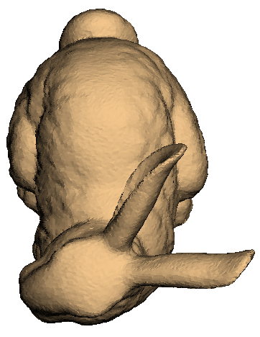
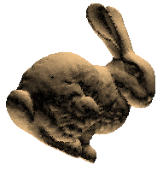
Moment Invariants
Moment invariants are functions of the moments of a shape, which are independent of the coordinate system
So they are invariant to Euclidean or affine transformations of the data set.
For Example: these are one type of invariants of moments of degree 4 of the bunny mesh,
and they are almost the same for different rotation/scales.
0.16713084 0.27336454 0.5595046 0.019233907 0.026759103 0.058509145
0.16713084 0.27336454 0.5595046 0.019233907 0.026759105 0.05850915
0.16713084 0.27336454 0.5595046 0.019233907 0.026759105 0.058509145
0.16713084 0.27336454 0.5595046 0.019233907 0.026759105 0.05850915
0.16713084 0.27336454 0.5595046 0.019233907 0.026759105 0.05850915
4.165E-7
1.862E-7
4.165E-7
4.165E-7

Slide 5
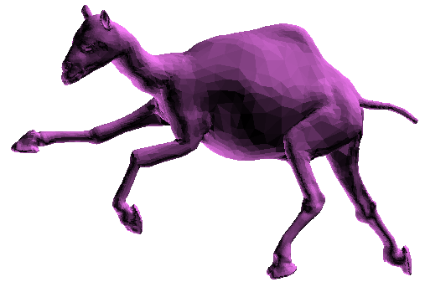
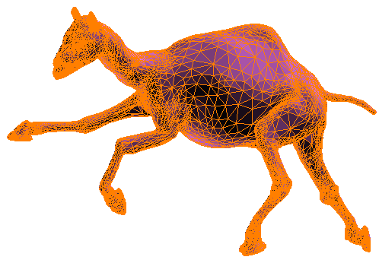
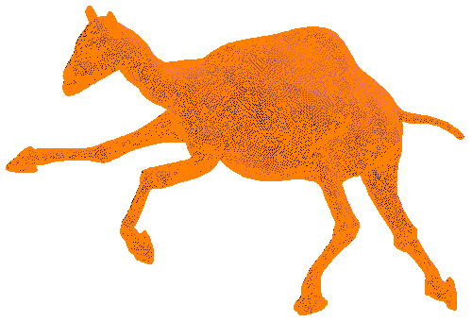
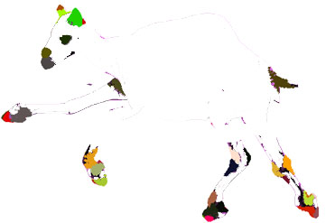
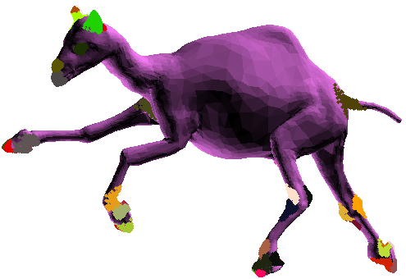
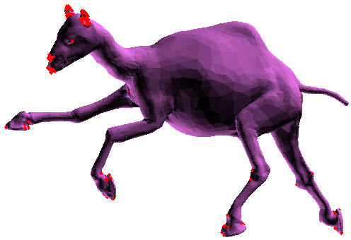
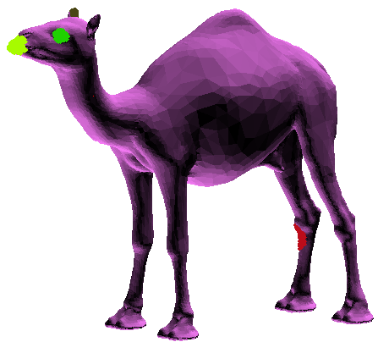
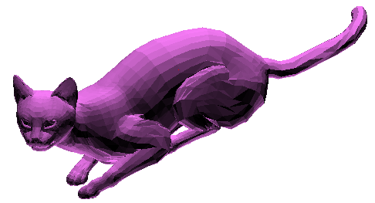
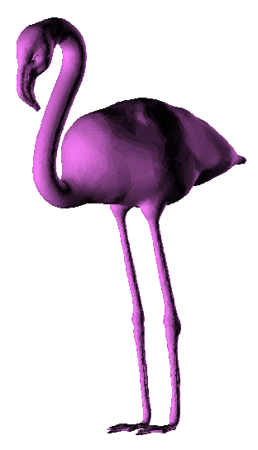
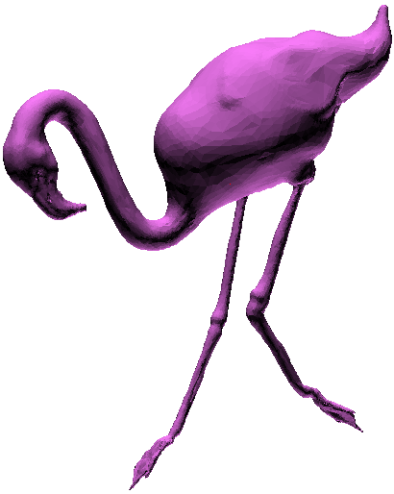
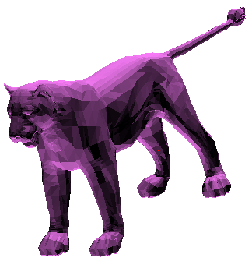
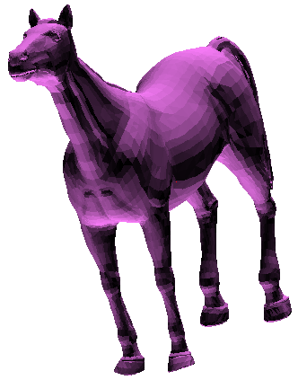
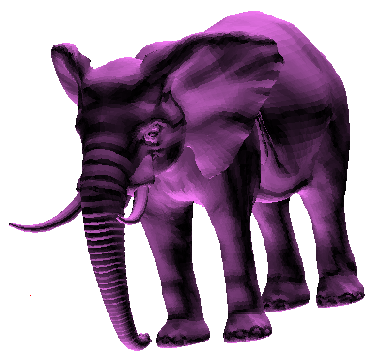
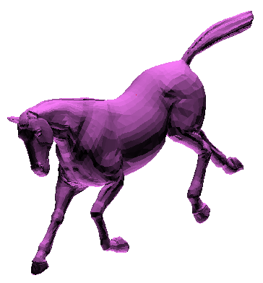
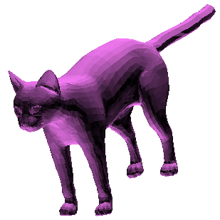
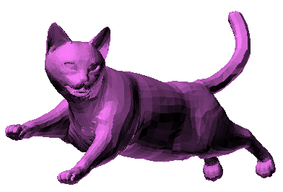
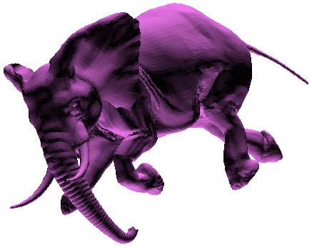
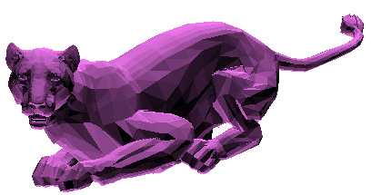
General System Steps
Query Mesh
Regular and Uniform
Remeshing
Interest Points
Interest Regions
Comparing Moment Invariants
Finding Moment Invariants
Result Mesh
Local Moment Invariants Database
…

Slide 6
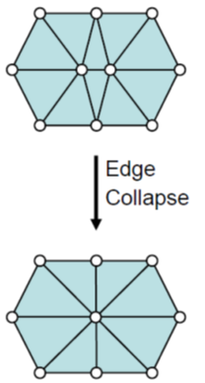
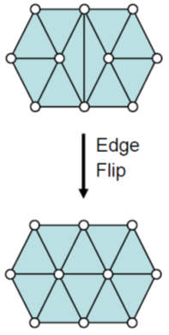
Step 1: Remeshing
We need a regular and uniform mesh in order to compute the moments.
There are two categories of Remeshing:
Parameterization-based
Map to 2D domain / 2D problem
Computationally more expensive
Surface-oriented
Operate directly on the surface
Efficient for high resolution remeshing

Slide 7
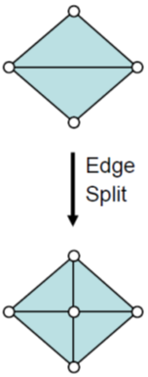
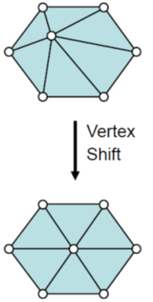
Incremental Remeshing
Compute target edge length L
Split edges longer than L_{max} = (4/3 * L)
Collapse edges shorter than L_{min} = (4/5 * L)
Flip edges to get closer to valence 6
Vertex shift by tangential relaxation

Slide 8
Splitting Edges
3.5
3.5
For every triangle in the mesh:
Compute Edges Lengths
If Edge Length > L_{max}, add vertex to that edge
Split triangle using the new edges
Cases:
2
2 Edges Split
3 Edges Split
No Splitting
1 Edge Split

Slide 9
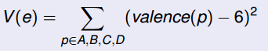
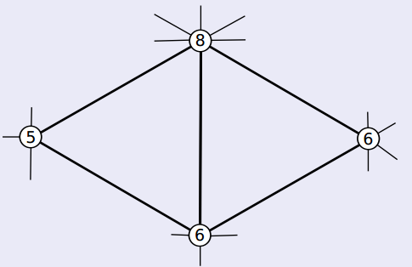
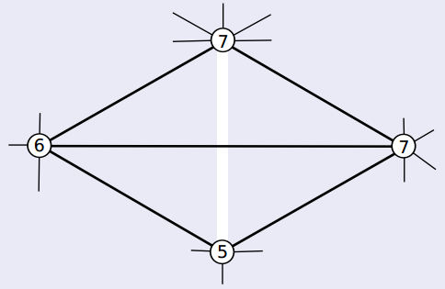
Flip Edges
We perform edge-ﬂipping in order to regularize the connectivity
So for every edge in the mesh,
we compute the valences of the two neighboring triangles before flipping V(e₁)
and after flipping V(e₂).
If the valences after flipping is more regular (closer to 6) , we do the flipping, otherwise not.
V(e₁)=5
V(e₂)=3

Slide 10
Tangential Relaxation
Local “spring” relaxation
Using uniform Laplacian smoothing

Slide 11
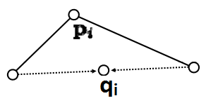
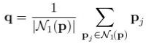
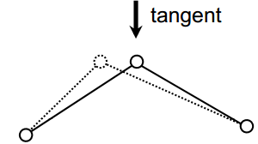
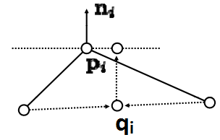
Tangential Relaxation
Compute Bary-center of one-ring neighbors:
But we want to restrict the vertex movement to tangent plane (to keep the vertex approx. on surface)
by projecting q onto the vertex tangent plane:
p’ = q + nn^{T}(p - q)

Slide 12
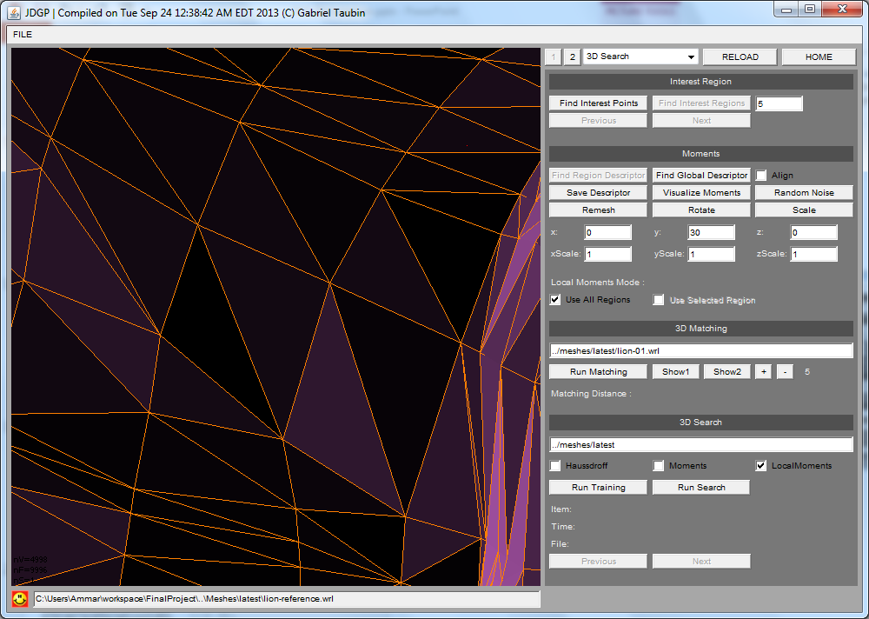
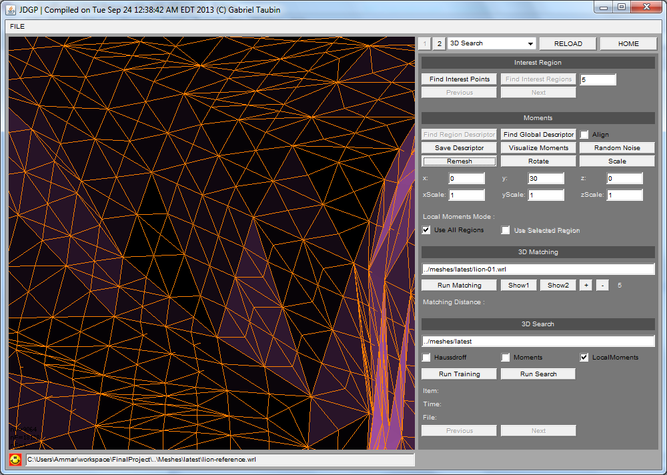
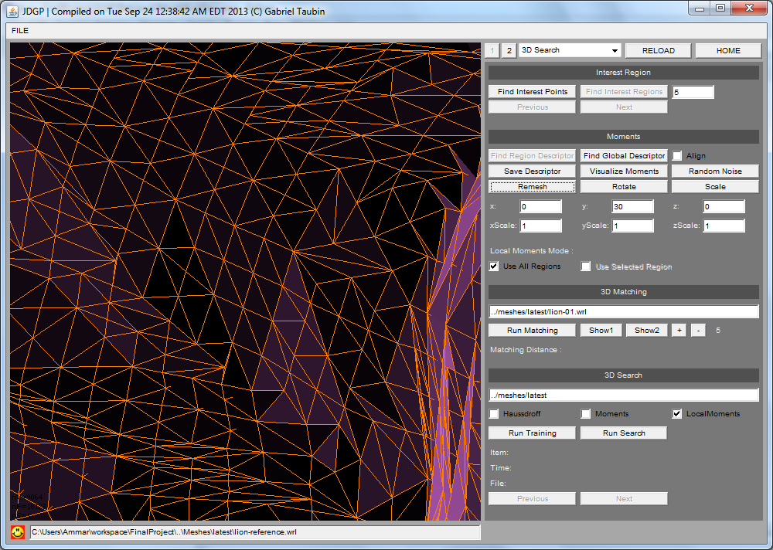
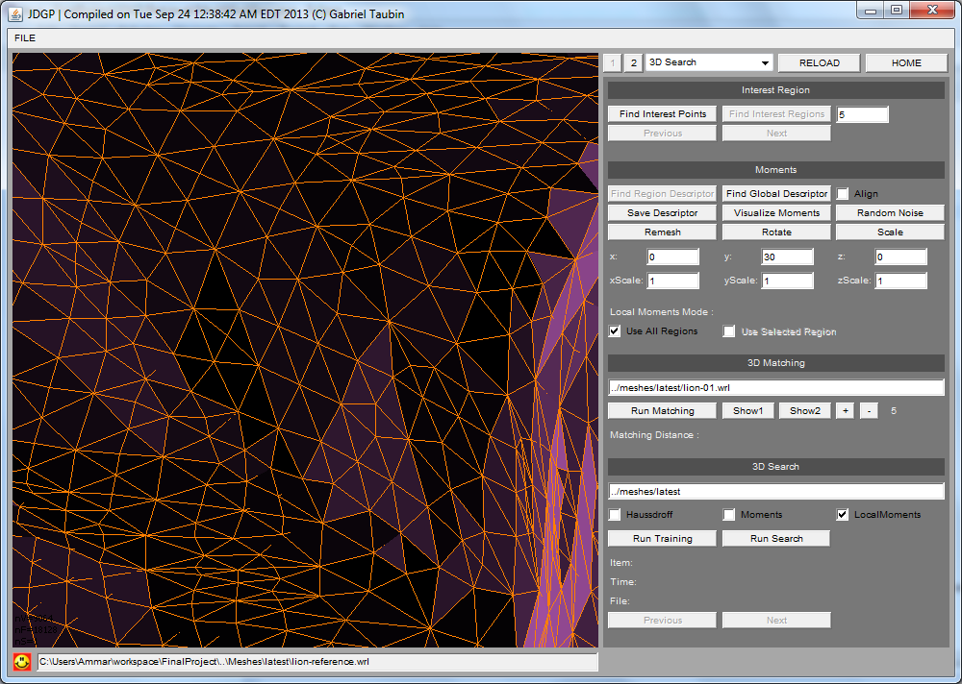
1. Original Mesh
2. After Splitting Edges
2. After Flipping Edges
4. After Tangential Relaxation

Slide 13
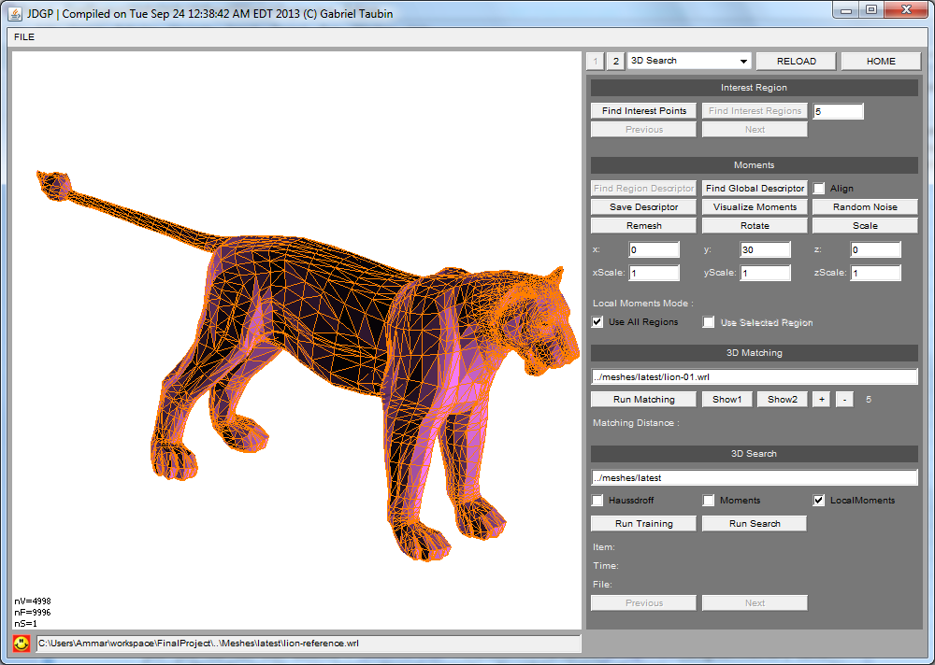
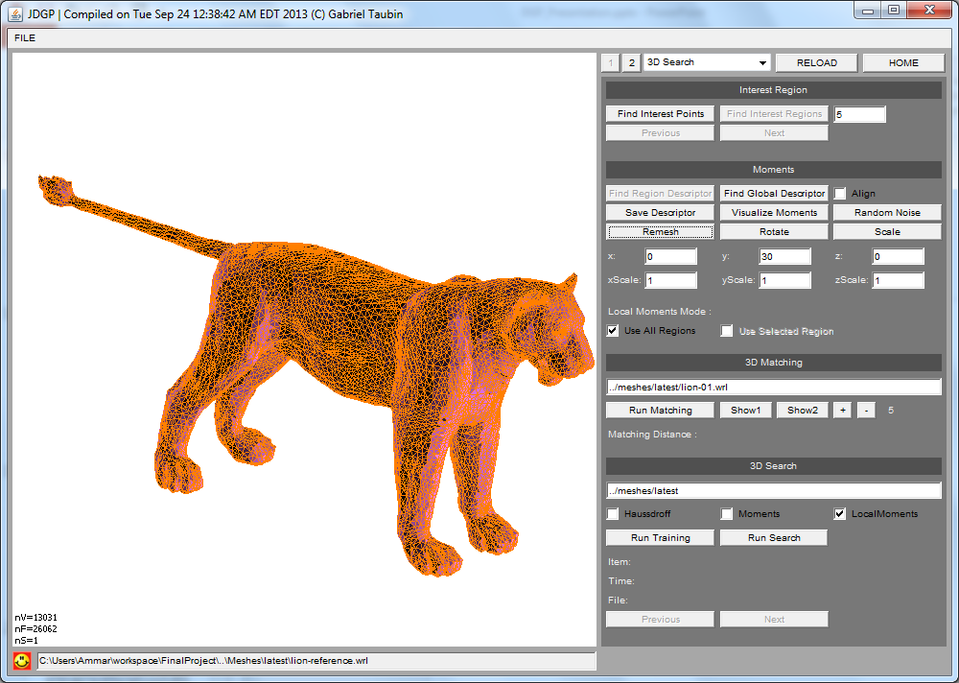
Remeshing Example

Slide 14
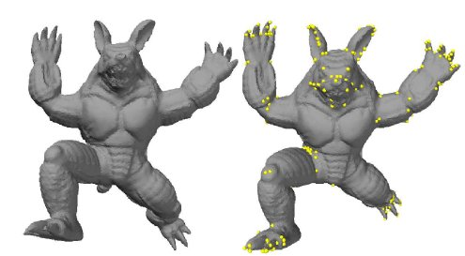
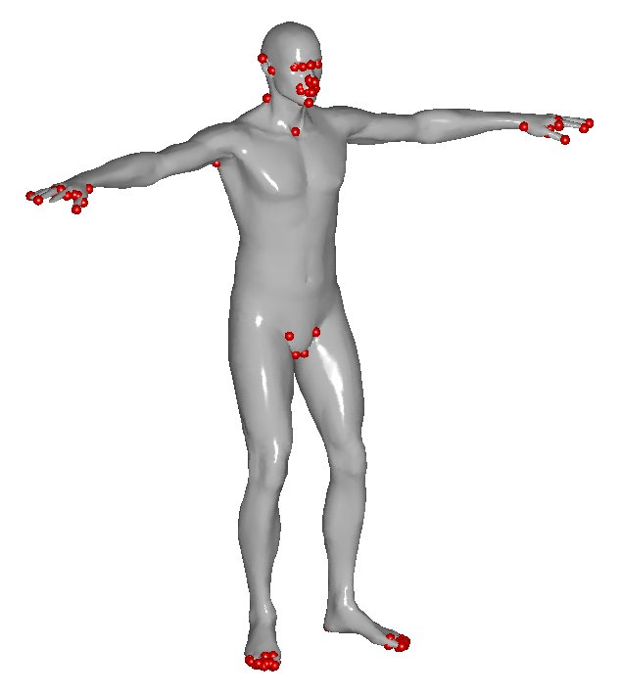
Step 2: Finding Interest Points
We need to select few regions of the mesh “Interest Regions”
To allow retrieval for partially occluded meshes, or only using one part of the mesh
Also to allow retrieval for meshes with non-rigid transformations
So we decided to use Harris 3D interest points detector

Slide 15
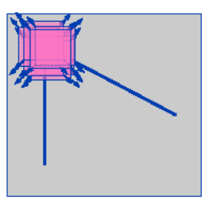
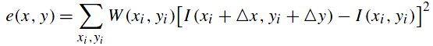

Harris Image Corner Detection
By using a window and detecting a corner when there is a significant change in all directions
Window Function
Shifted Intensity
Intensity
Using Taylor Expansion:
Harris Response:

Slide 16





Harris 3D
Extension of Harris Image Corner Detector
finds a canonical local system
Find Neighbor Rings
For Every Vertex
By PCA
Fit a quadratic surface
(Paraboloid)
Gaussian functions of the derivatives
Compute Harris Response h(x,y)
Compute the Derivatives
On the Surface
By Least Square
Harris Response:

Slide 17







Some Harris 3D Result

Slide 18
Step 3: Finding Interest Regions
Then we expand the interest points by static or adaptive number of rings to have the interest regions

Slide 19





Interest Regions
5 Rings
7 Rings

Slide 20
Step 4: Moment Invariants
We need to have an efficient method with low computational cost.
As shown in [Taubin 1991], We could store moments in Matrices, and apply efficient matrix operations such as (computation of Eigen Values) to get the Moment Invariants.

Slide 21
Moments Matrices
So in order to store moments in Matrices, we need to define a specific order,
so will use the Lexicographical order of Multiindices α, β :
α < β , if for the ﬁrst index k such that α_{k} differs from β_{k}; we have α_{k} > β_{k}
Example: Multiindex of size 1
( 1, 0, 0 )
<
( 0, 1, 0 )
<
( 0, 0, 1 )
Example: Multiindex of size 2
( 2, 0, 0 )
<
( 1, 1, 0 )
<
( 1, 0, 1 )
<
( 0, 2, 0 )
<
( 0, 1, 1 )
<
( 0, 0, 2 )
Example: Multiindex of size 3
( 3, 0, 0 )
<
( 2, 1, 0 )
<
( 2, 0, 1 )
<
( 1, 2, 0 )
<
( 1, 1, 1 )
<
( 1, 0, 2 )
<
( 0, 3, 0 )
<
( 0, 2, 1 )
<
( 0, 1, 2 )
<
( 0, 0, 3 )

Slide 22


Moments Matrices
So we define the matrix using a set of monomials lexicographically ordered
=
For Example:

Slide 23
Moments Matrices
Then for each Matrix of Monomial :
we define the Matrix of Centered Moments

Slide 24

Example: Computing M_{[2,2]}
Initialize moments matrix M_{[2,2]} ( 6 × 6 ) to zeros.
For Every Triangle in the Mesh
Get Triangle vertices coordinates x1, y1, z1, x2, y2, z2, x3, y3, z3.
Compute Triangle Area
Compute Matrix of Monomials as described before
Add Matrix to M_{[2,2]}
Normalize, matrix M_{[2,2]} by dividing on total triangles area.
Compute Eigen values of M_{[2,2]} by using Eigen value decomposition (provided by Jama package)
These are the Moment Invariants

Slide 25
Example: Computing M_{[2,2]}
So In the example of the bunny mesh, these are the Eigen Values of
and
Eigen Values
Eigen Values
Eigen Values
Eigen Values
Eigen Values
0.16713084 0.27336454 0.5595046 0.019233907 0.026759103 0.058509145
0.16713084 0.27336454 0.5595046 0.019233907 0.026759105 0.05850915
0.16713084 0.27336454 0.5595046 0.019233907 0.026759105 0.058509145
0.16713084 0.27336454 0.5595046 0.019233907 0.026759105 0.05850915
0.16713084 0.27336454 0.5595046 0.019233907 0.026759105 0.05850915
4.165E-7
1.862E-7
4.165E-7
4.165E-7

Slide 26
Step 5: 3D Matching
Now we have a set of regions and moment invariants of two 3D Models.
We compute the Euclidean Distance between every pair of regions of Model 1 and Model 2.
Then we sort the pairs by distance, get the top N number of pairs with lowest distance, and compute the total matching distance out of that.
Moment Invariants
Moment Invariants
Region 1
3.2 1.1 3.9 8.1 5.25 …
8.2 7.1 9.9 8.1 3.25 …
Region 2
5.2 4.1 6.9 3.1 0.25 …
0.2 3.1 6.9 3.1 0.55 …
Region 3
3.3 7.1 3.9 8.1 5.25 …
5.3 5.1 3.9 5.1 5.25 …
Region 4
9.2 8.1 5.9 0.1 0.25 …
2.2 8.1 5.9 0.1 0.25 …
2.2 1.1 4.9 8.1 0.25 …
…
Region 5
3.2 1.1 4.9 3.1 0.25 …
Model 1
…
…
Model 2

Slide 27




3D Matching Examples:
Top 5 Regions
Matching Distance: 0.0158
Top 13 Regions
Matching Distance: 0.118

Slide 28




3D Matching Examples:
Top 5 Regions
Matching Distance: 0.0225
Top 13 Regions
Matching Distance: 0.0939

Slide 29




3D Matching Examples:
Top 5 Regions
Matching Distance: 1.274E-4
Top 13 Regions
Matching Distance: 0.00328

Slide 30




3D Matching Examples:
Top 5 Regions
Matching Distance: 0.00182
Top 13 Regions
Matching Distance: 0.0240

Slide 31
Step 6: 3D Retrieval
The 3D retrieval is performed by computing the matching distance between a query 3D model and every other 3D model in the database
Then sort the search results by matching distance

Slide 32













3D Retrieval Example
Query:
Time: 4.8s
Using Top 5 Regions
Results:
0.00129
0.00323
0.00481
0.00597
0.0120
0.0127
0.0128
0.0151
0.0158
0.0185
0.0419
0.0452

Slide 33










3D Retrieval Example
Query:
Time: 1.4s
Using Top 5 Regions
Results:
0.0230
0.0305
0.0313
0.0345
0.0487
0.0507
0.0519
0.0525
0.0527

Slide 34









3D Retrieval Example
Query:
Time: 4.9s
Using Top 5 Regions
Results:
6.99E-5
1.134E-4
3.16E-4
4.33E-4
5.00E-4
0.0018
0.028
0.0305

Slide 35

Visualizing Moments

Slide 36
Conclusions
Using Matrix operations for calculating moment invariants is a very fast and efficient algorithm.
On my tests, the query time was 1-6 seconds depending on the complexity of the model and the size of the database.
This is very fast compared to brute force search; using Haussdroff distance for example which takes several minutes for a database of 100 models.
A large portion of the query time was taken by the interest points detector.
So although Harris 3D is an accurate interest points detector, its performance could be enhanced.

Slide 37
Future Steps
Trying to use Moment Invariants for interest points and regions detection
Using space partitioning algorithms (ex: like ANN) to efficiently find the nearest features of a database of features.
Compare the performance of moment invariants as a local descriptor with other local descriptors

Slide 38
Main References
Data Set:
Sumner, Robert W., and Jovan Popović. Mesh Data from Deformation Transfer for Triangle Meshes. (2004)
http://people.csail.mit.edu/sumner/research/deftransfer/data.html
Taubin, Gabriel, and David B. Cooper. Object recognition based on moment (or algebraic) invariants. IBM TJ Watson Research Center, 1991.
Zhang, Cha, and Tsuhan Chen. "Efficient feature extraction for 2D/3D objects in mesh representation." Image Processing, 2001. Proceedings. 2001 International Conference on. Vol. 3. IEEE, 2001.
Sipiran, Ivan, and Benjamin Bustos. "Harris 3D: a robust extension of the Harris operator for interest point detection on 3D meshes." The Visual Computer 27.11 (2011): 963-976.
Botsch, Mario, et al. Polygon mesh processing. P.100: Incremental Remeshing . 2010.
Liu, Zhen-Bao, et al. "A Survey on Partial Retrieval of 3D Shapes." Journal of Computer Science and Technology 28.5 (2013): 836-851.
Lindsay I Smith. “A tutorial on Principal Components Analysis”. 2002

Slide 39
Extra References
Alliez, Pierre, et al. "Isotropic surface remeshing." Shape Modeling International, 2003. IEEE, 2003.
Prokop, Richard J., and Anthony P. Reeves. "A survey of moment-based techniques for unoccluded object representation and recognition." CVGIP: Graphical Models and Image Processing 54.5 (1992): 438-460.
Tangelder, Johan WH, and Remco C. Veltkamp. "A survey of content based 3D shape retrieval methods." Multimedia tools and applications 39.3 (2008): 441-471.
Kazhdan, Michael M. Shape representations and algorithms for 3D model retrieval. Diss. Princeton University, 2004.
Sipiran, Ivan, and Benjamin Bustos. "Key-components: detection of salient regions on 3D meshes." The Visual Computer 29.12 (2013): 1319-1332.
Sun, Jian, Maks Ovsjanikov, and Leonidas Guibas. "A Concise and Provably Informative Multi‐Scale Signature Based on Heat Diffusion." Computer Graphics Forum. Vol. 28. No. 5. Blackwell Publishing Ltd, 2009.
http://www.astro.utu.fi/edu/kurssit/f90/f90/english/pdf/numfit2.pdf

Slide 40
END

Slide 41
Backup Slides

Slide 42
3D Retrieval Applications
3D Recognition (ex: Face, Ear)
CAD/CAM
Archaeology
3D protein retrieval
Others…

Slide 43
Harris 3D
Our algorithm works in a vertex-wise manner in order to compute the Harris response for each vertex:
It determines a neighborhood for each vertex. It can be spatial, adaptive or ring neighborhoods.
It finds a canonical local system by applying PCA to the neighborhood.
It fits a quadratic surface on the normalized neighborhood.
It computes derivatives on the fitted surface. Gaussian functions are used for smoothing the derivatives. By using integration between the derivatives and the gaussians, the method is robust to local geometric changes.
Using the derivatives, the algorithm constructs the auto-correlation function needed to evaluate the Harris operator. Subsequently, a response is computed for each vertex.

Slide 44
Descriptors
Measuring similarity
In order to measure how similar two objects are, it is necessary to compute distances between pairs of descriptors using a dissimilarity measure
Efﬁciency
For large shape collections, it is inefﬁcient to sequentially match all objects in the database with the query object. Because retrieval should be fast, efﬁcient indexing search structures are needed to support efﬁcient retrieval

Slide 45
Descriptors
Discriminative power:
A shape descriptor should capture properties that discriminate objects well
Robustness and sensitivity
It is often desirable that a shape descriptor is insensitive to noise and small extra features, and robust against arbitrary topological degeneracies, e.g. if it is obtained by laser scanning

Slide 46
How we used moment invariants
The matching of arbitrarily shaped regions is done by computing for each region a vector of centered moments. These vectors are viewpoint dependent, but the dependence on the viewpoint is algebraic and well known. We then compute moment invariants, i.e., algebraic functions of the moments that are invariant to Euclidean or affine transformations of the data set

Slide 47
Moment
In mathematics, a moment is a quantitative measure of the shape of a set of points (its related to mean, variance, skewness…etc)
We define the moment of a polynomial f(x) with respect to a shape μ as the normalized integral
the data is a sampled version of a n-dimensional nonnegative integrable density
function μ(x)

Slide 48
Definitions
Multiindex:
Its size:
Monomial:
=
Its degree:
There are
different multiindices of size d
lexicographical order
Every monomial defines a corresponding centered moment:
the mean, or center, of the data set described by μ :

Slide 49
Moments and Monomials
=
=

Slide 50


Partial Matching Techniques
Methods based on local descriptors
Spin Images, Local Spherical Harmonics, Heat Kernel Signature (HKS), 3D Shape Context, 3D SIFT, HoG, DoG…etc
Methods based on segmentation
Methods based on view

Slide 51
Harris 3D Equations
A = P₄² + 2 P₁² + 2 P₂²
B = P₅² + 2 P₂² + 2 P₃²
C = P₄ P₅ + 2 P₁ P₂ + 2 P₂ P₅
Harris Response:

